Slide 1
CGB1201 – JAVA PROGRAMMING
Department of Artificial Intelligence and Data Science
Academic Year: 2024 – 2025 (Odd Semester)
Register Number : 2303811724322096
Name : Santhiya S
Year : Second Year
Semester : Third Semester
Section : B
Date : 03.12.24

Slide 2
Title of the Project
PARCEL TRACKING SYSTEM

Slide 3
Problem Identification
In the current logistics and parcel delivery landscape, one of the most significant challenges is the lack of transparency and real-time tracking for parcels.
Customers often face uncertainty about the exact location and status of their deliveries, leading to frustration and dissatisfaction.
This lack of visibility reduces transparency, leading to a decline in customer trust and satisfaction.

Slide 4
Objective
The primary objective of this project is to design and develop a parcel tracking system that provides real-time status updates and location information for parcels throughout their journey from dispatch to delivery.
The system aims to enhance transparency by offering customers detailed insights into the progress of their parcels at every stage.

Slide 5
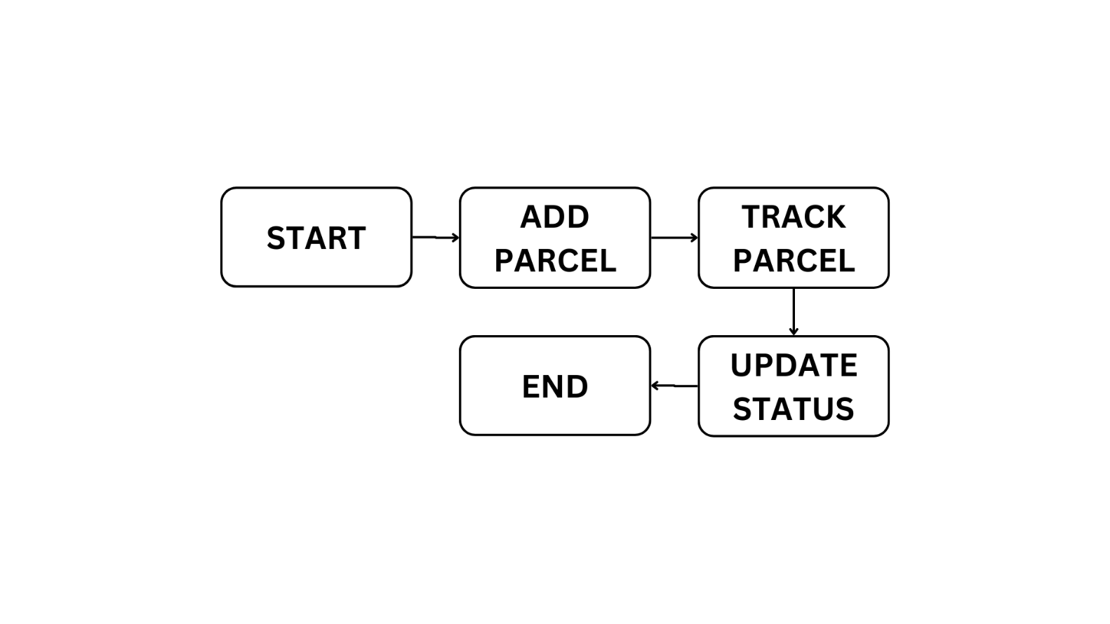
Proposed Architecture

Slide 6
Java Programming - Concepts Used
HashMap: The program uses a HashMap to store parcels using their unique Parcel ID as the key. This allows for efficient retrieval of parcel data based on the Parcel ID.
Random: The Random class is used to simulate the selection of random locations for the parcel's current and destination addresses from a predefined list of Tamil Nadu cities.

Slide 7
Java Programming - Concepts Used
Event Listeners: The program listens for user actions (such as button clicks) using event listeners. The ActionListener interface is used for responding to events triggered by the "Add Parcel" and "Track Parcel" buttons.

Slide 8
List of Modules
ADD PARCEL
TRACK PARCEL
UPDATE STATUS

Slide 9
Module Description
ADD PARCEL:
This module allows users to input parcel details such as the parcel ID, sender name, and receiver name.
Once the information is submitted, the system assigns a starting location and a delivery destination randomly from predefined locations.
It ensures that each parcel ID is unique, displaying error messages if a duplicate ID is entered.

Slide 10
Module Description (Cont..)
TRACK PARCEL:
The track parcel module retrieves the parcel's details using the unique parcel ID.
Users can track the current status and location of the parcel in real-time.
This module simulates the journey of the parcel through distinct stages—such as "In Transit" or "Out for Delivery"—before reaching its destination.

Slide 11
Module Description (Cont..)
UPDATE STATUS:
It dynamically updates the status of a parcel at regular intervals during the tracking process.
It integrates with the graphical interface to display real-time updates, ensuring transparency and keeping the user informed.

Slide 12
Source Code
import java.awt.*;
import java.awt.event.*;
import java.util.HashMap;
import java.util.Map;
import java.util.Random;
public class AddParcelAWT extends Frame {
static Map<String, Parcel> parcels = new HashMap<>();
static String[] locations = { "Chennai", "Coimbatore", "Madurai", "Trichy", "Salem", "Erode", "Tirunelveli", "Vellore", "Thoothukudi", "Dindigul" };
TextField parcelIdField, senderField, receiverField;
TextArea statusArea;
Button addParcelButton;

Slide 13
Source Code
addParcelButton.addActionListener(e -> addParcel());
addWindowListener(new WindowAdapter() { public void windowClosing(WindowEvent e) { System.exit(0); } }); }
void addParcel() { String parcelId = parcelIdField.getText();
if (parcels.containsKey(parcelId)) { statusArea.setText("Parcel ID already exists!");
return; }
String sender = senderField.getText();
String receiver = receiverField.getText();
Random random = new Random();
String currentLocation = locations[random.nextInt(locations.length)];
String receiverLocation = locations[random.nextInt(locations.length)];
while (currentLocation.equals(receiverLocation)) { receiverLocation = locations[random.nextInt(locations.length)]; }

Slide 14
Source Code
trackParcelButton.addActionListener(e -> trackParcel());
addWindowListener(new WindowAdapter() {
public void windowClosing(WindowEvent e) { System.exit(0); } }); }
void trackParcel() {
String parcelId = parcelIdField.getText();
if (!parcels.containsKey(parcelId)) { statusArea.setText("Parcel ID not found!"); return; }
AddParcelAWT.Parcel parcel = parcels.get(parcelId);
statusArea.setText("Tracking Parcel: " + parcelId); new Thread(() -> { try { parcel.status = "In Transit"; updateStatus(parcelId, parcel); Thread.sleep(60000);
parcel.status = "Out for Delivery";
updateStatus(parcelId, parcel); Thread.sleep(60000);
parcel.status = "Delivered"; parcel.currentLocation = parcel.receiverLocation; updateStatus(parcelId, parcel); }
catch (InterruptedException ex) { ex.printStackTrace(); } }).start();

Slide 15
Source Code
void updateStatus(String parcelId, AddParcelAWT.Parcel parcel) { statusArea.setText("Tracking Parcel: " + parcelId + "\n" + "Status: " + parcel.status + "\n" + "Current Location: " + parcel.currentLocation + "\n" + "Receiver Location: " + parcel.receiverLocation); }
public static void main(String[] args) {
new TrackParcelAWT().setVisible(true); } }

Slide 16
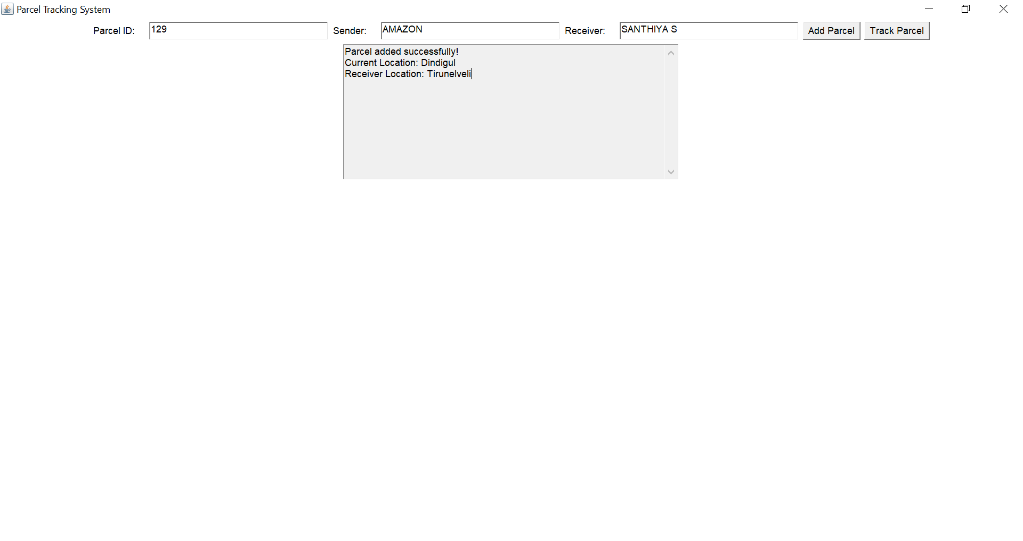
Results
1)ADD PARCEL

Slide 17
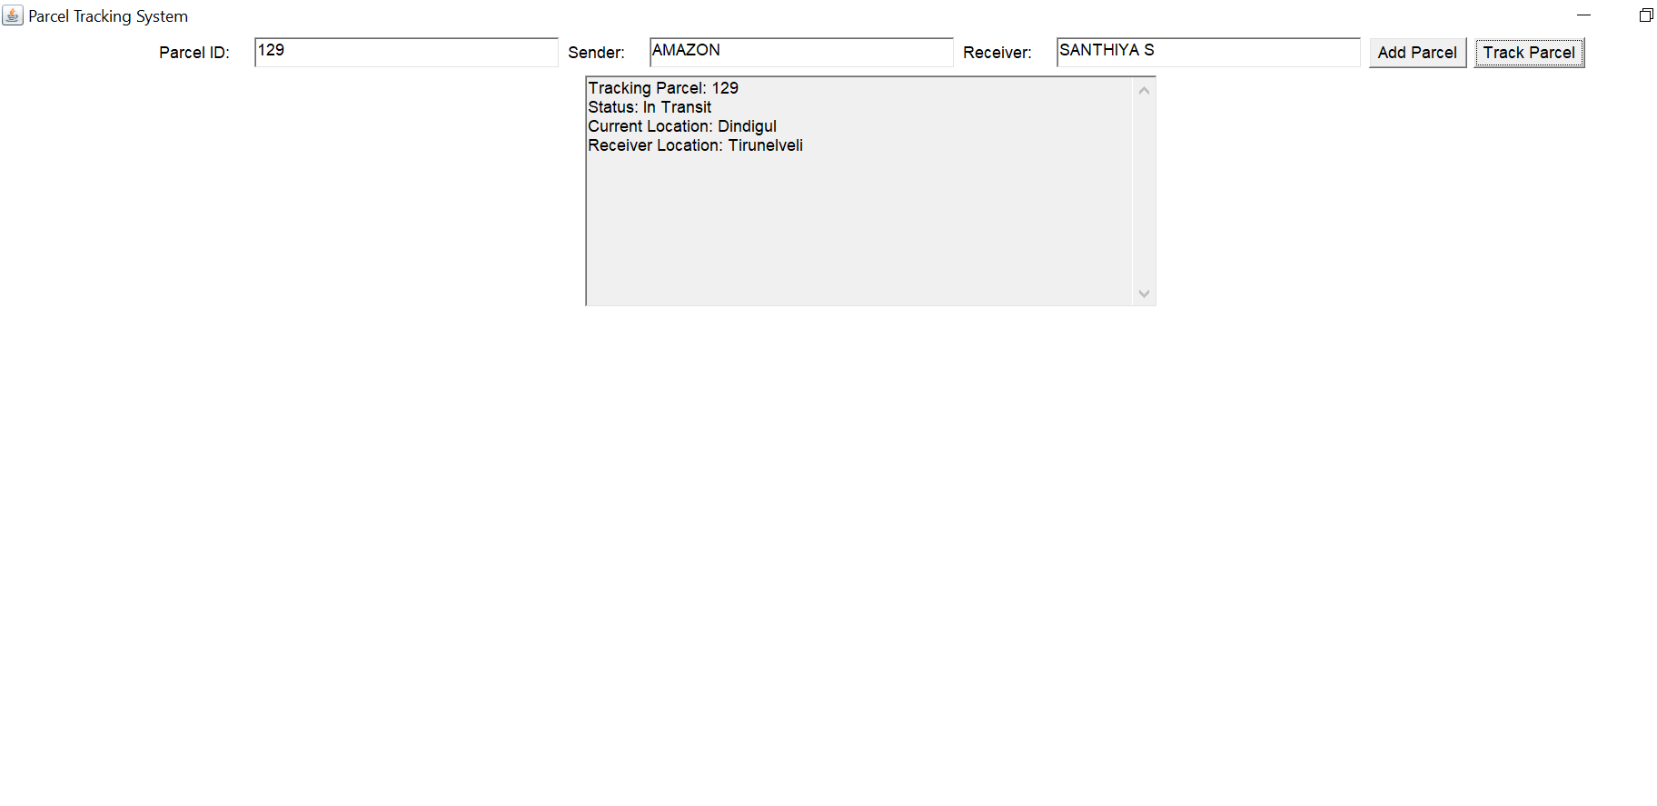
Results
2)TRACK PARCEL

Slide 18
Conclusion
In conclusion, the Parcel Tracking System demonstrates an efficient and interactive approach to managing parcel deliveries using Java and AWT.
The system enables users to add parcels, assign unique IDs, and track their status in real time through a user-friendly graphical interface.
By leveraging multithreading, dynamic status updates, and predefined location data, the application simulates the real-world parcel delivery process effectively.

Slide 19
Thank You

